Slide 1
Big Data
Abhishek Dubey

Slide 2
Big Data + AI
Notes:
Given the widespread applicability and pervasiveness of CPS around us, it is very important to ensure that we make it resilient.

Slide 3
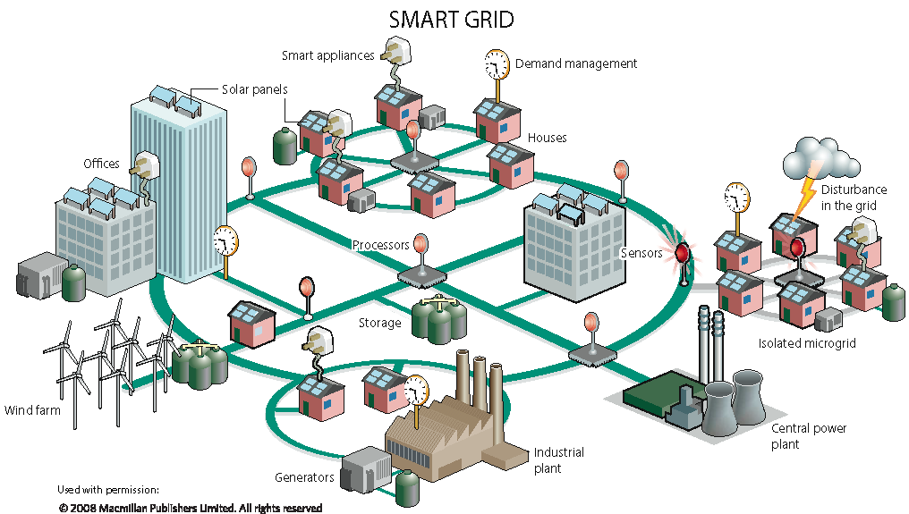
Big Data + AI
Smart Grid
Notes:
Given the widespread applicability and pervasiveness of CPS around us, it is very important to ensure that we make it resilient.

Slide 4
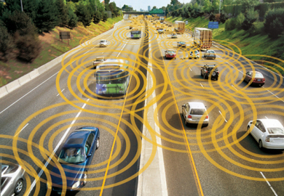
Big Data + AI
Smart Grid
Smart Transportation
Smart Grid
Notes:
Given the widespread applicability and pervasiveness of CPS around us, it is very important to ensure that we make it resilient.

Slide 5
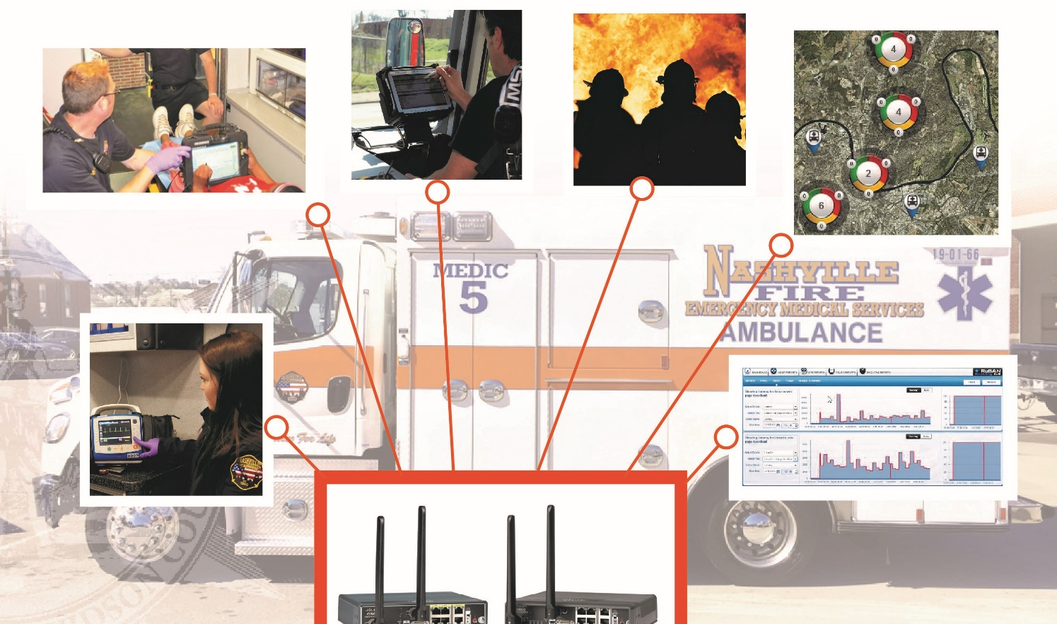
Big Data + AI
Smart Grid
Smart Transportation
Smart Grid
Smart Emergency Response
Smart Transportation
Notes:
Given the widespread applicability and pervasiveness of CPS around us, it is very important to ensure that we make it resilient.

Slide 6
Big Data Era
Google: “Every 2 Days We Create As Much Info As We Did Up To 2003”
Facebook: “500+ TB of New Data Each Day”
Twitter: “500 million tweets per day.”
Source: TechCrunch, August 2010, http://techcrunch.com/2010/08/04/schmidt-data/
Source: Gigaom.com, August 2012, http://bit.ly/13wyPj7
Source: Twitter Blog, August 2013, http://bit.ly/14ySYrr
6
Notes:
We’re generating a lot of data now. It’s one thing to just store it. It’s another thing to be able to try to make sense of it.

Slide 7



Volume
Velocity
Variety

Slide 8
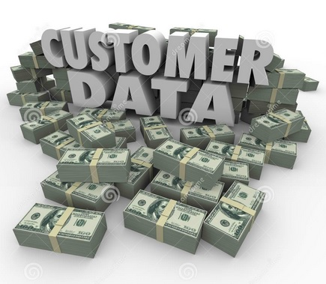
Data has value
http://newsbytes.ph/2015/10/15/gartner-customer-data-has-monetary-value-but-many-firms-ignore-it/

Slide 9
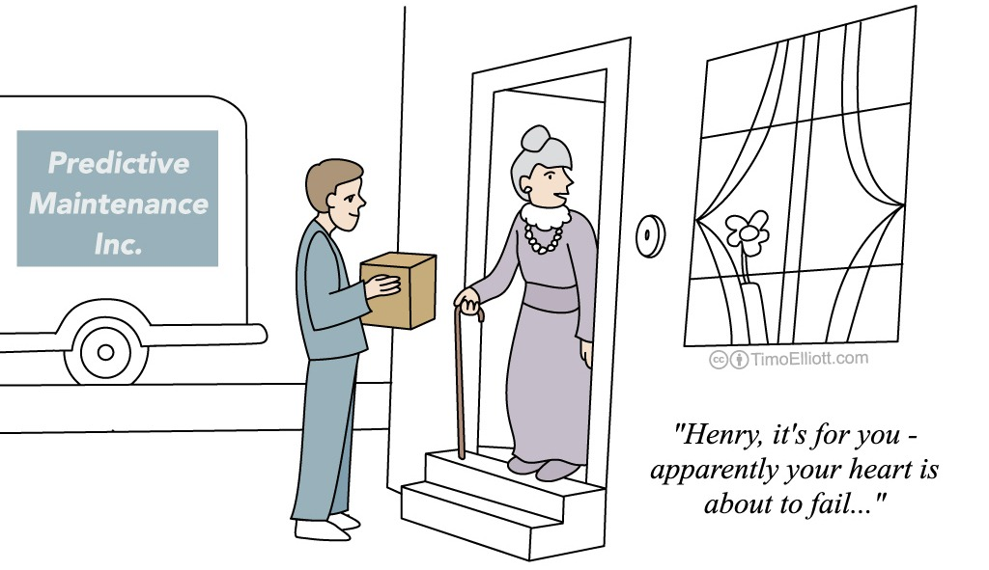
Decision Making
Use data to inform every aspect of our lives.
Medicine.
Public Policy.
Science.
Business.
9

Slide 10
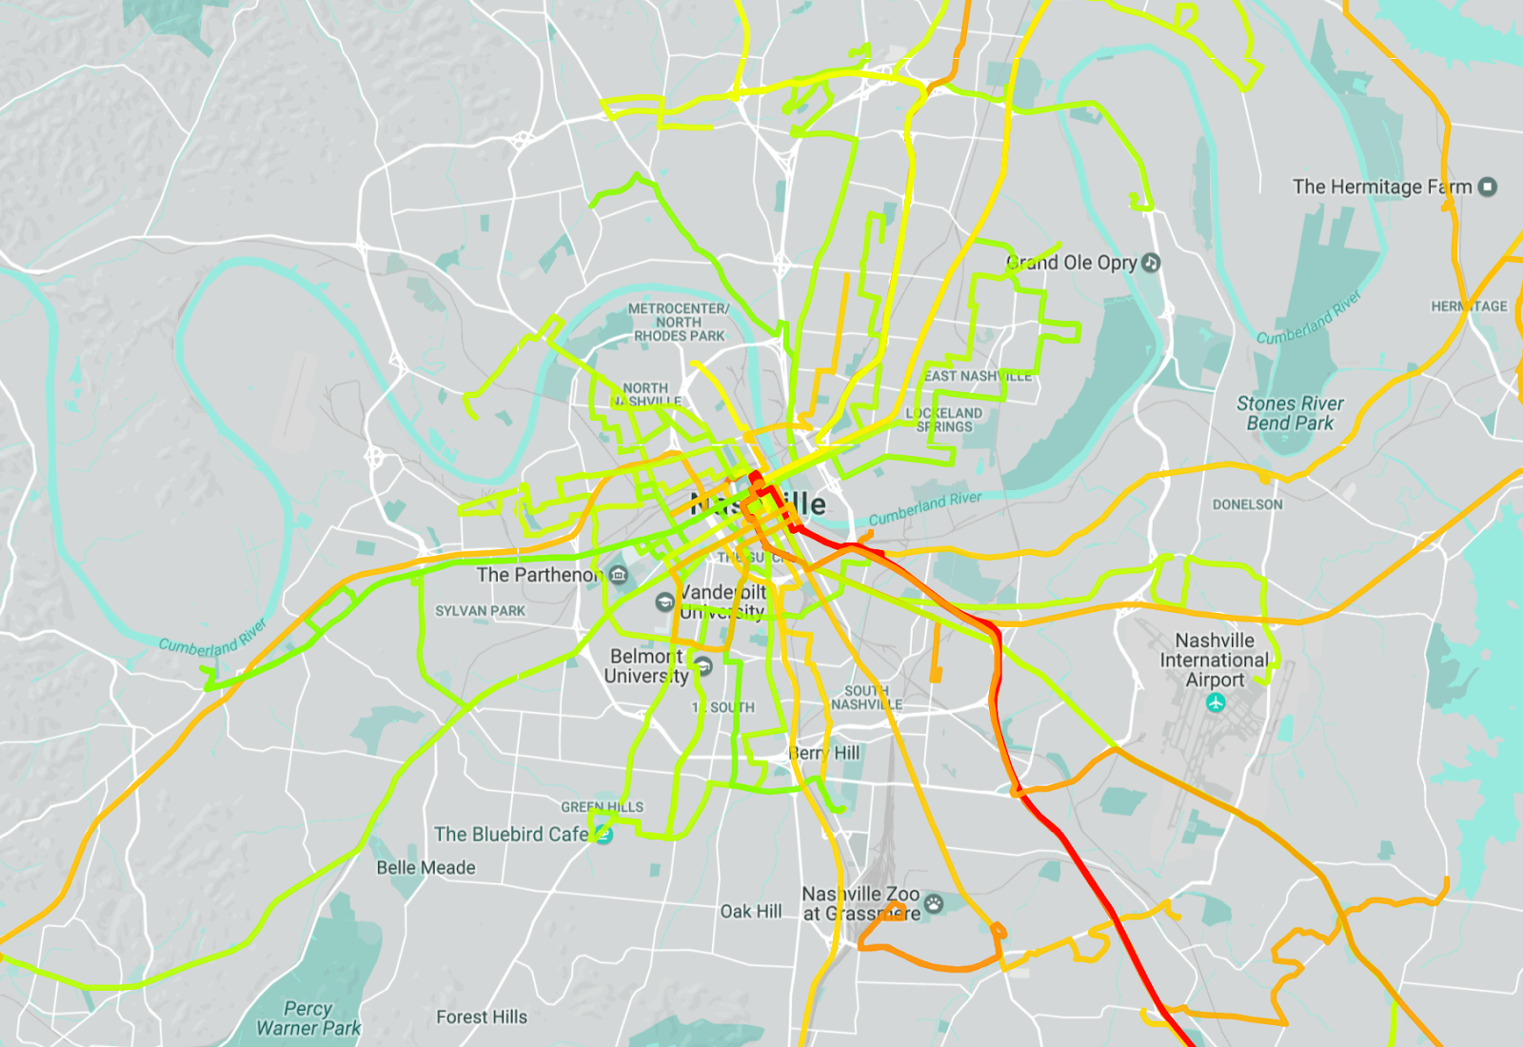
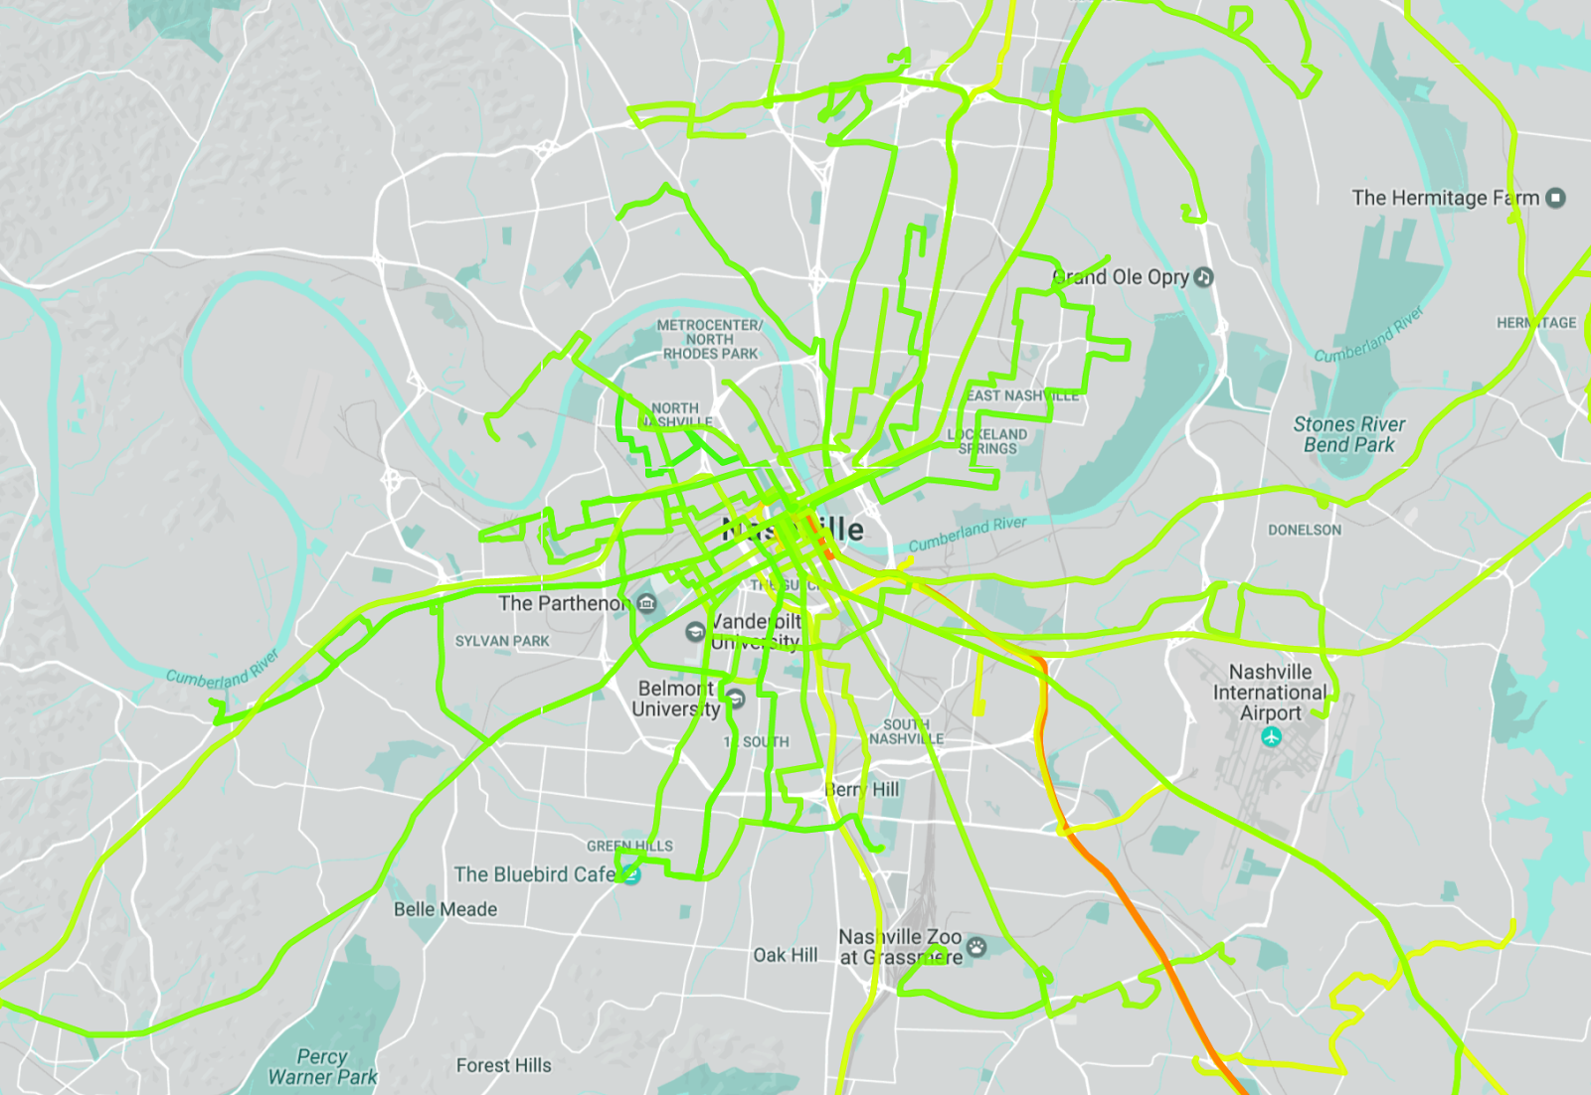
Public Transit Improvement
■ 90%
■ 70%
■ 50%
■ 30%
■ 10%
■ 90%
■ 70%
■ 50%
■ 30%
■ 10%
Original
Optimized (in Simulation)
Showing percentages of trips before and after schedule update arrival delay at time points is between [-1 min, +6 min]

Slide 11
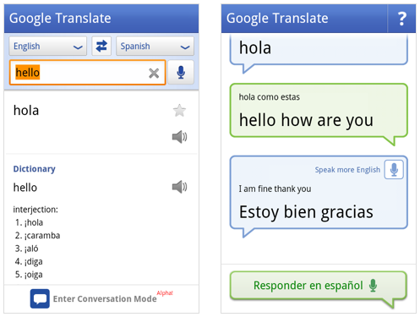
Language Translation
11

Slide 12
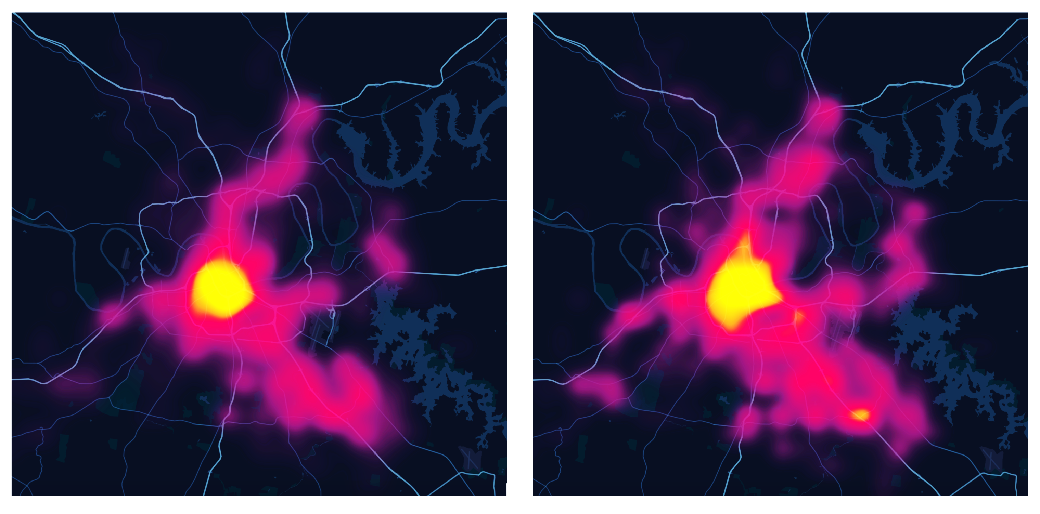
Public Safety
Comparison of (1) incidents predicted by model (left), and (2) real incident distribution (right) over January 2019

Slide 13
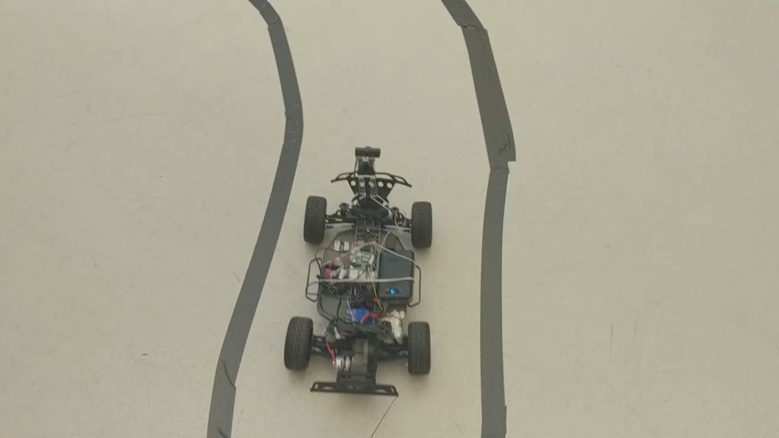
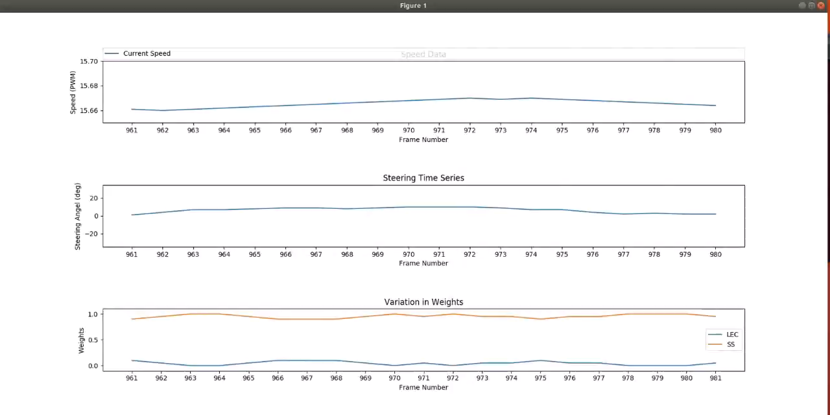
Self-Driving Cars

Slide 14
So what is big Data

Slide 15
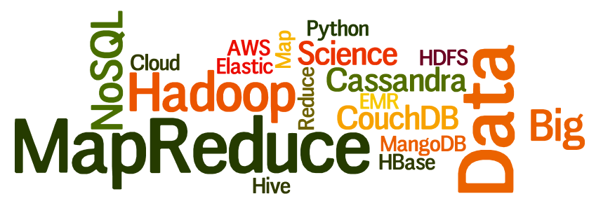
The many words of Big Data

Slide 16
Glorified Plumbing
Processing
Storing data
Supporting ML

Slide 17
Example: requirements of a Smart City Data Store
Must handle high Velocity/Volume data.
Efficient mechanisms for querying and processing geospatial data.
Real time processing is a requirement.
Resilient.
Data has high Variety – MDS, HERE, custom data models.
Extendable – as new applications are added, system should be able to add new data models without taking system off-line.

Slide 18
Traditional Approach: Client-Server Model
User triggers communication with server through web browser – makes a request.
Web server includes multiple processes awaiting requests. When request is received – routes the request to resource/application logic to process request.
Application logic communicates with data model to query, access or update data as needed.

Slide 19
Traditional Approach
Ref: https://en.wikipedia.org/wiki/LAMP_(software_bundle)

Slide 20
VolumE – The Big Bottleneck

Slide 21
System Demands
Financial applications - User x needs to access very specific data related to that person.
Twitter – request stream from person y, need to find specific data (tweets) tagged for that person.
Record 1
Record 2
Record 3
Record 4
Record 5
Key Question: How do we efficiently find record 4 in a data store of millions of records?
Record 6
……
Record n

Slide 22
SQL Databases
SQL databases arose to efficiently store structured data.
While structured? Structured data provides a predictable format that can be tailored to specific applications.
Properly structured data can fit seamlessly into application logic.

Slide 23
SQL Data Model
Rooted in relational logic.
Support complex data retrieval – joins.
Find individual records, combine result and return to application.

Slide 24
Indexing
To help retrieve data efficiently, fields can be indexed.
B-tree is most common.
Efficient for both finding individual elements (traditional web applications) and aggregation queries (batch processing discussed later …)
B-tree insertion

Slide 25
Volume – Storage Demand
Terabytes (Petabytes) of new data.
Not possible to store all data in one node - vertical scaling not a viable solution.
Requirement: data store must scale horizontally. Data must be stored across multiple nodes.
Ref: https://medium.com/@abhinavkorpal/scaling-horizontally-and-vertically-for-databases-a2aef778610c

Slide 26
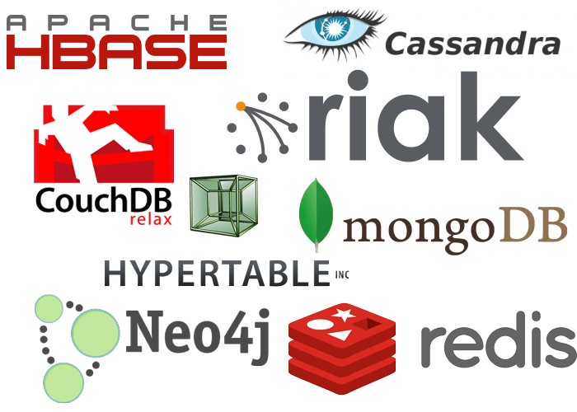
Handling Volume - NoSQL
SQL built for vertical scaling.
Limitations led to revisiting how we structure data.
NoSQL: a general term for database systems not based on SQL
Common models:
Key-value -> fast lookup, great for in memory caches and storage (DynamoDB, Memcached, Redis).
Document models -> stores data as “records”, typically JSON. Great for unstructured data (MongoDB, CouchDB). Easy sharding across nodes.
Graph models -> stores data as a mathematical graph structure, great for performing traversal queries and working with highly inter-connected data.
Improved scalability, but NOT ACID
Coding complexity passed to developer
Ref: https://neo4j.com/blog/neo4j-doc-manager-polyglot-persistence-mongodb/

Slide 27
Example
Multiple data models can be used in the same application where each model is selected as optimal solution to a specific objective.
Ref: https://neo4j.com/blog/neo4j-doc-manager-polyglot-persistence-mongodb/

Slide 28

NewSQL DBS
Scalability with ACID (for some types of queries)
Typically used for HUGE databases spanning data centers
Slower than simpler NoSQL / RDBMs
May require atomic clocks…see Google’s Spanner.
Google Spanner

Slide 29
The Big Data Storage Landscape
Value of an individual data item
Value of data in aggregate
NoSQL
App Complexity / Data Size
NoSQL
New SQL
Traditional RDBMS
Data Age
Other axes to consider: Response Time

Slide 30
Processing – The Second Bottleneck

Slide 31

Big Data Problem
Identifying trending topics on Twitter
Objective:
Find most frequently occurring hash tag today

Slide 32
Relational Databases (RDBMs)
SQL: ‘Easy’ to express complex queries
Designed to scale horizontally (partition data by location)
Schema makes it easier to understand data structure
SELECT get_first_hash_tag(tweet), count(*)
FROM tweets
WHERE tweet_dt = TODAY()
GROUP BY get_first_hash_tag(tweet)

Slide 33
Big Data Processing
Services (online systems) – traditional model. Service waits for request or instruction from client. Main requirement is find and handle small subsets of data quickly.
Batch processing (offline systems) – Takes a large amount of data and runs a long-running intensive process. Processes are scheduled periodically.
Stream processing (near-real-time systems) – Like batch processing, it consumes inputs and produces outputs. However operates on data and events as they come in.

Slide 34
The Big Data Storage Landscape
Value of an individual data item
Value of data in aggregate
Hadoop, MapReduce
NoSQL
App Complexity / Data Size
NoSQL
New SQL
Data Warehouse
Traditional RDBMS
Data Age
Other axes to consider: Response Time

Slide 35
Batch Processing
Jobs are periodically scheduled to run on large batches of data.
Outputs aggregated analysis.
Common for data analysts, Machine learning …
Examples – bank statements for all users at end of the month, aggregate monitoring statistics for IoT applications.

Slide 36
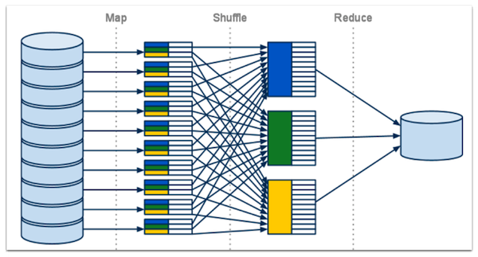
Batch Processing - MapReduce
Originally created by Google for parallel processing large batch jobs.
Data is split, mapping functions are applied to each subset and finally the processed outputs are combined and returned.
Computation is done in parallel
MapReduce
1) Map Step: <date_time, hash_tag>, 2) Reduce Step: Find most frequent

Slide 37
Distributed File Systems (HDFS)
MapReduce uses HDFS to store data as blocks of flat files. MapReduce jobs and processes are mapped over the nodes, file system closely resembles the MapReduce algorithm itself
HDFS

Slide 38
Stream Processing
Near real-time processing.
Apply lightweight functions to transform data as it arrives.
Spark is a common processing framework for real-real time streaming applications.

